Slide 1
Introduction
Most computer programs that solve real-world problems are much larger than the programs presented in the first few chapters.
Experience has shown that the best way to develop and maintain a large program is to construct it from smaller pieces, each of which is more manageable than the original program.
This technique is called divide and conquer.
This chapter describes some key features of the C language that facilitate the design, implementation, operation and maintenance of large programs.

Slide 2
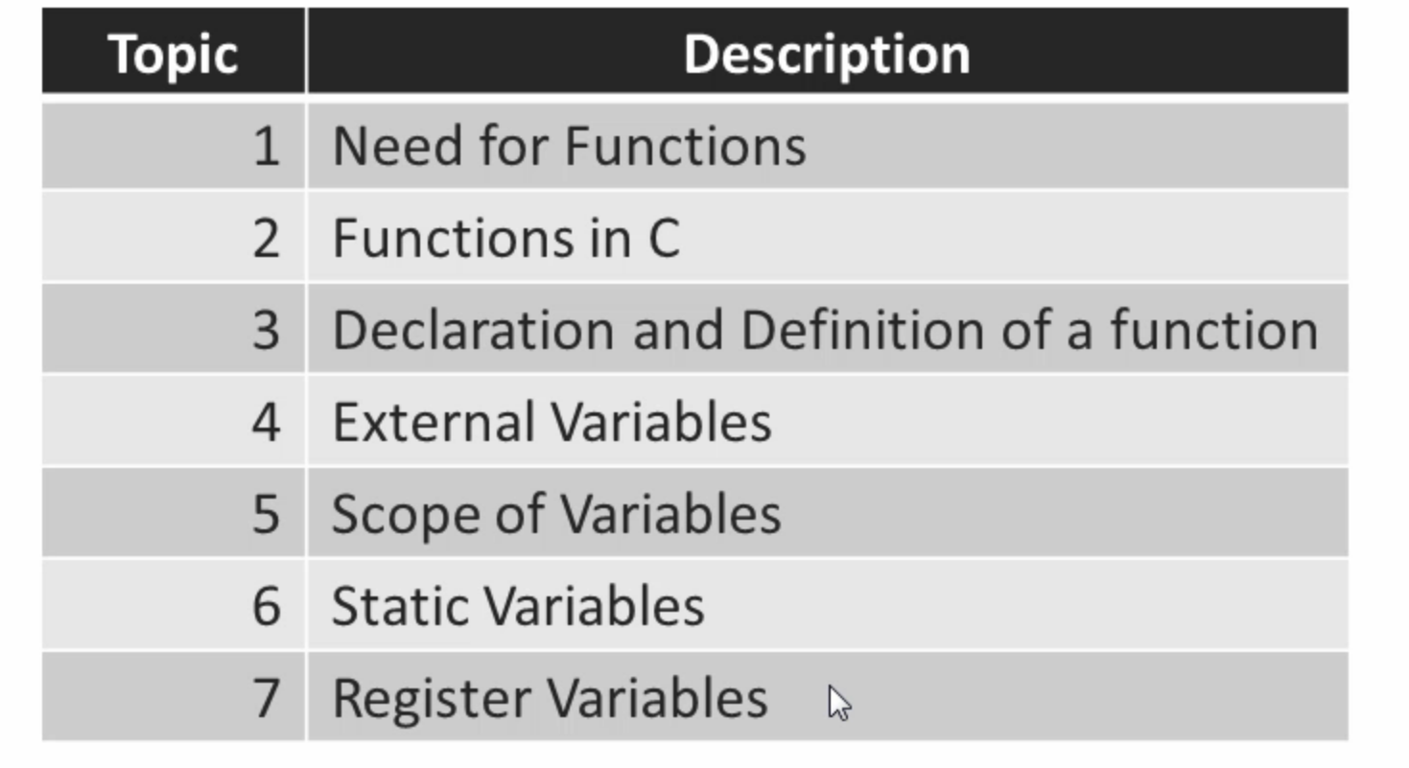

Slide 3
Modularizing Programs in C
Functions are used to modularize programs
C programs are typically written by combining new functions you write with prepackaged functions available in the C standard library.
The C standard library provides a rich collection of functions for performing common mathematical calculations, string manipulations, character manipulations, input/output, and many other useful operations.

Slide 4
Modularizing Programs in C (Cont.)
The functions printf, scanf and pow that we’ve used in previous chapters are standard library functions.
You can write your own functions to define tasks that may be used at many points in a program.
These are sometimes referred to as programmer-defined functions.
The statements defining the function are written only once, and the statements are hidden from other functions.
Functions are invoked by a function call, which specifies the function name and provides information (as arguments) that the called function needs to perform its designated task.

Slide 5
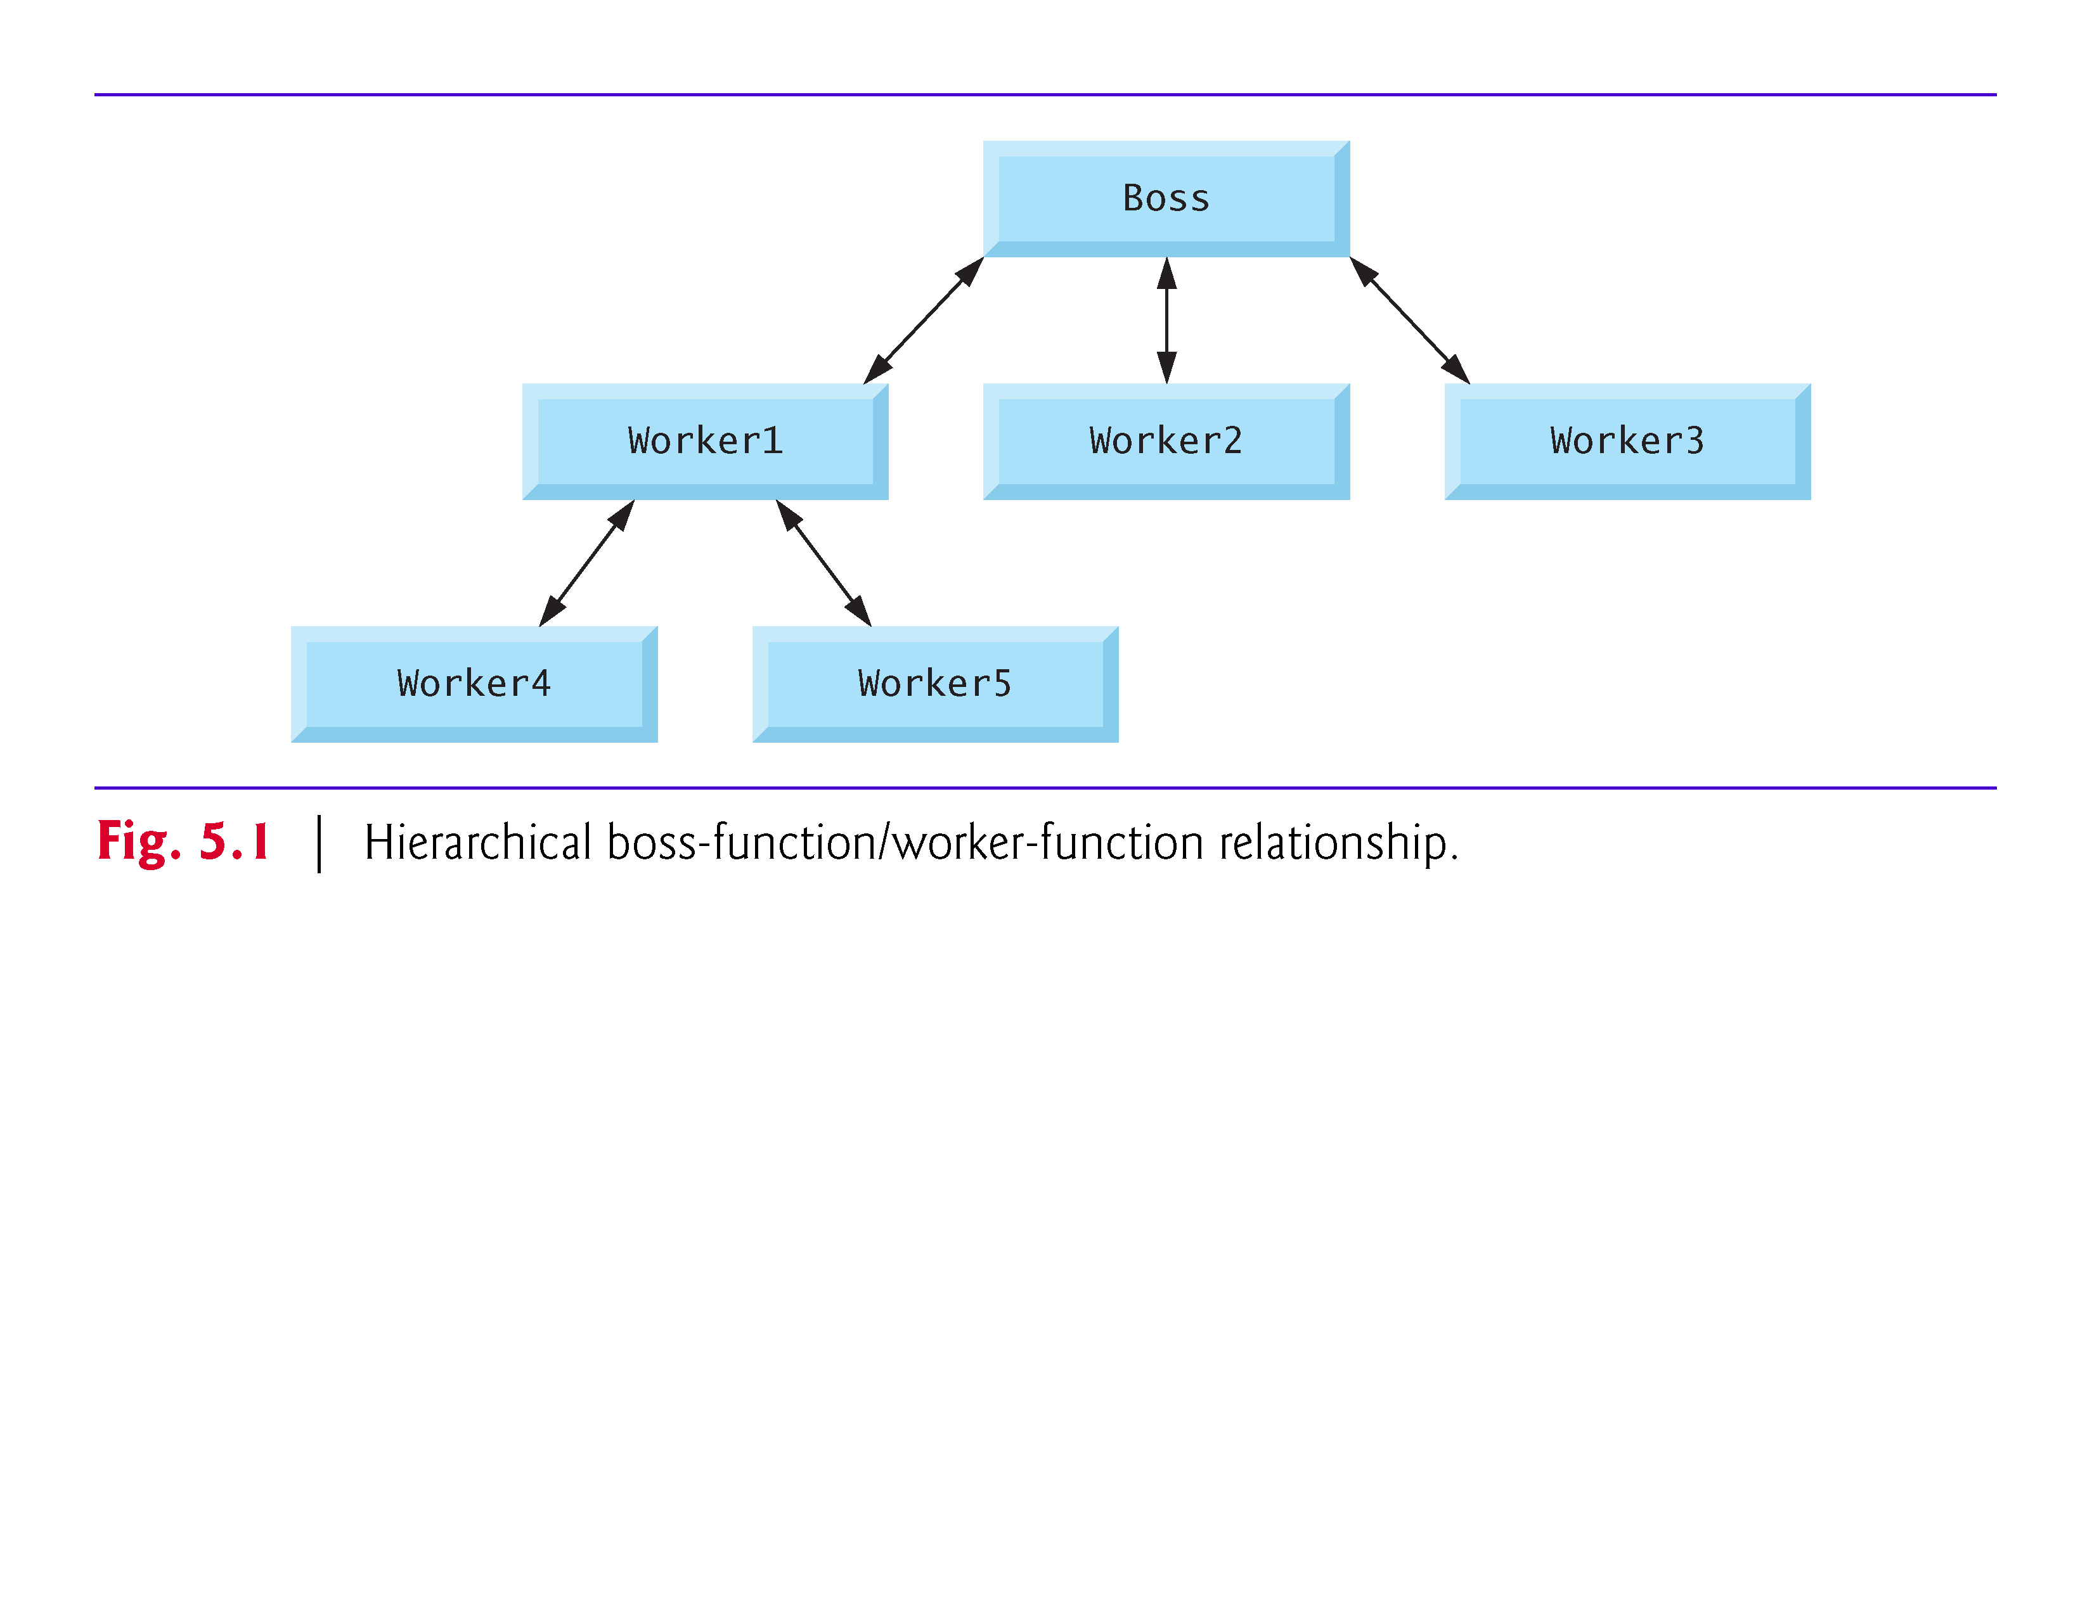

Slide 6
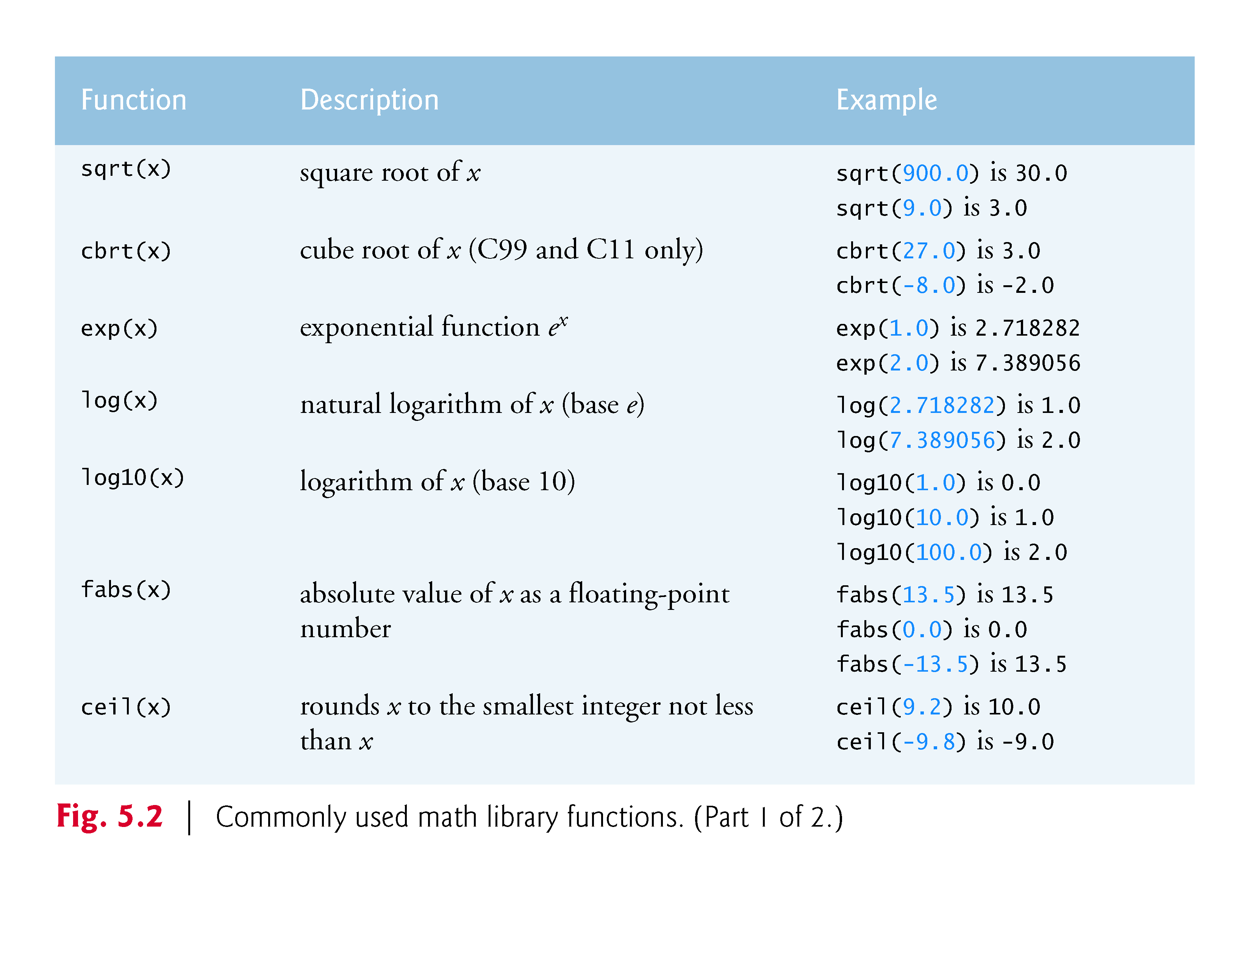

Slide 7
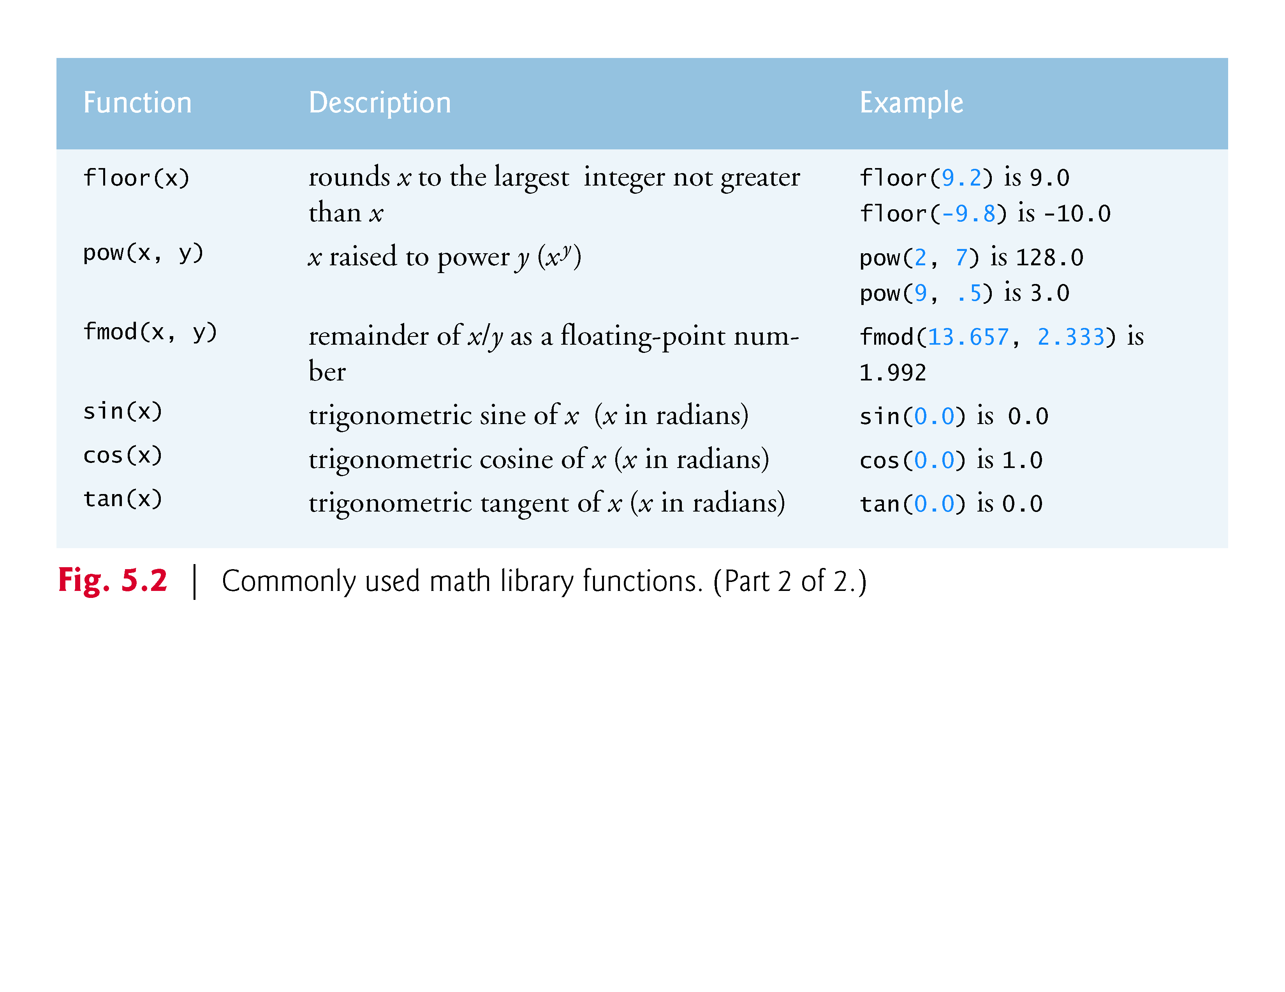

Slide 8
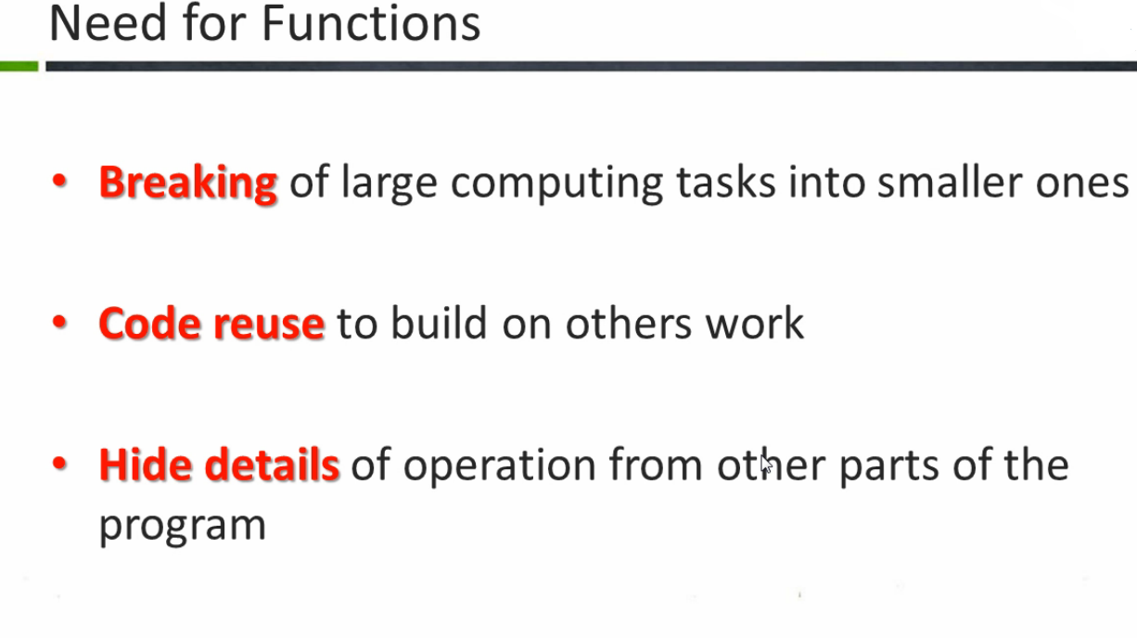

Slide 9
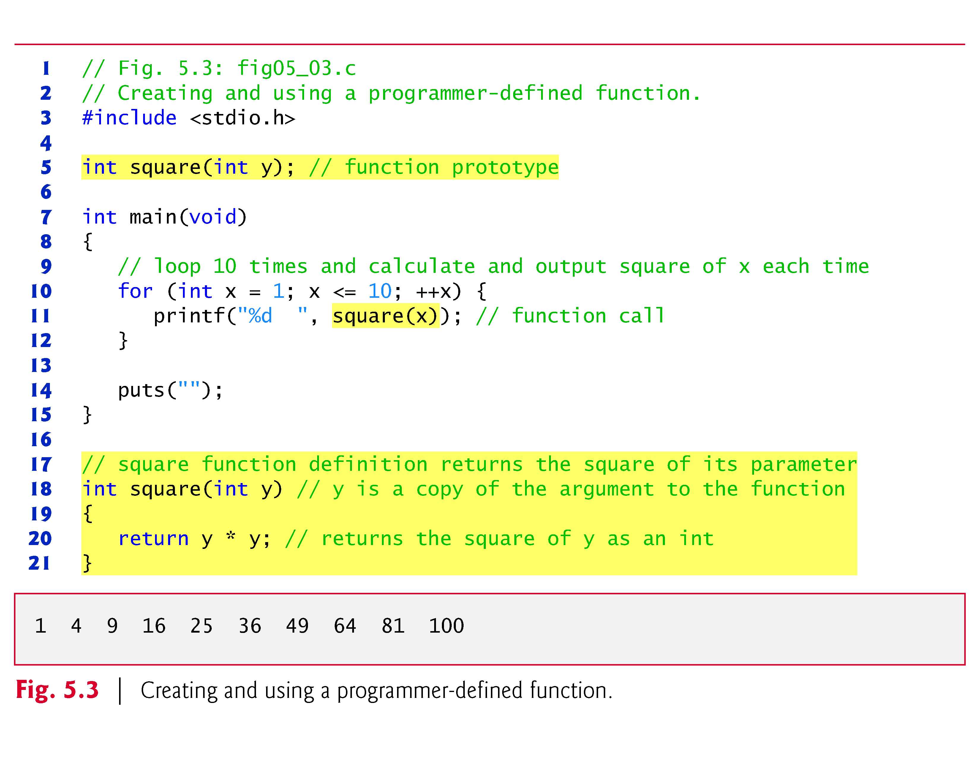

Slide 10
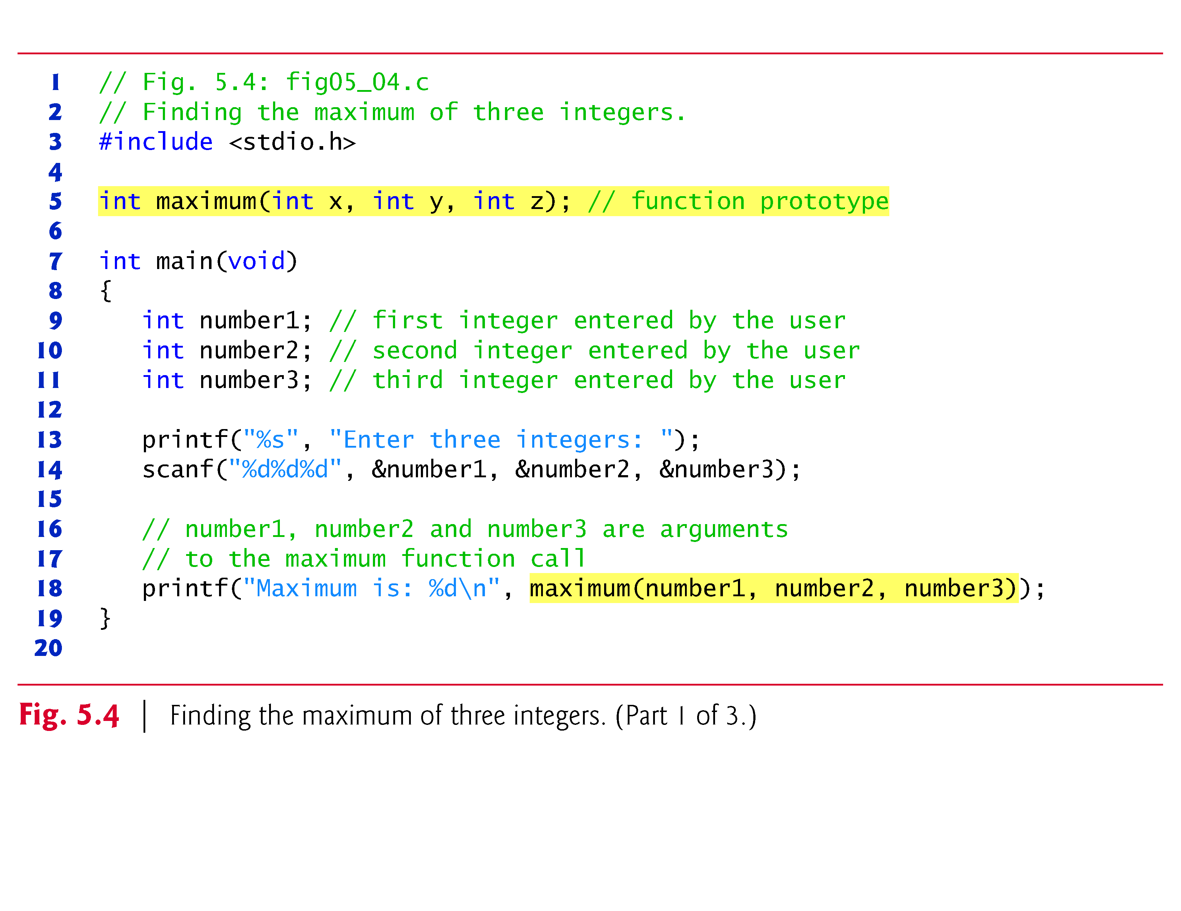

Slide 11
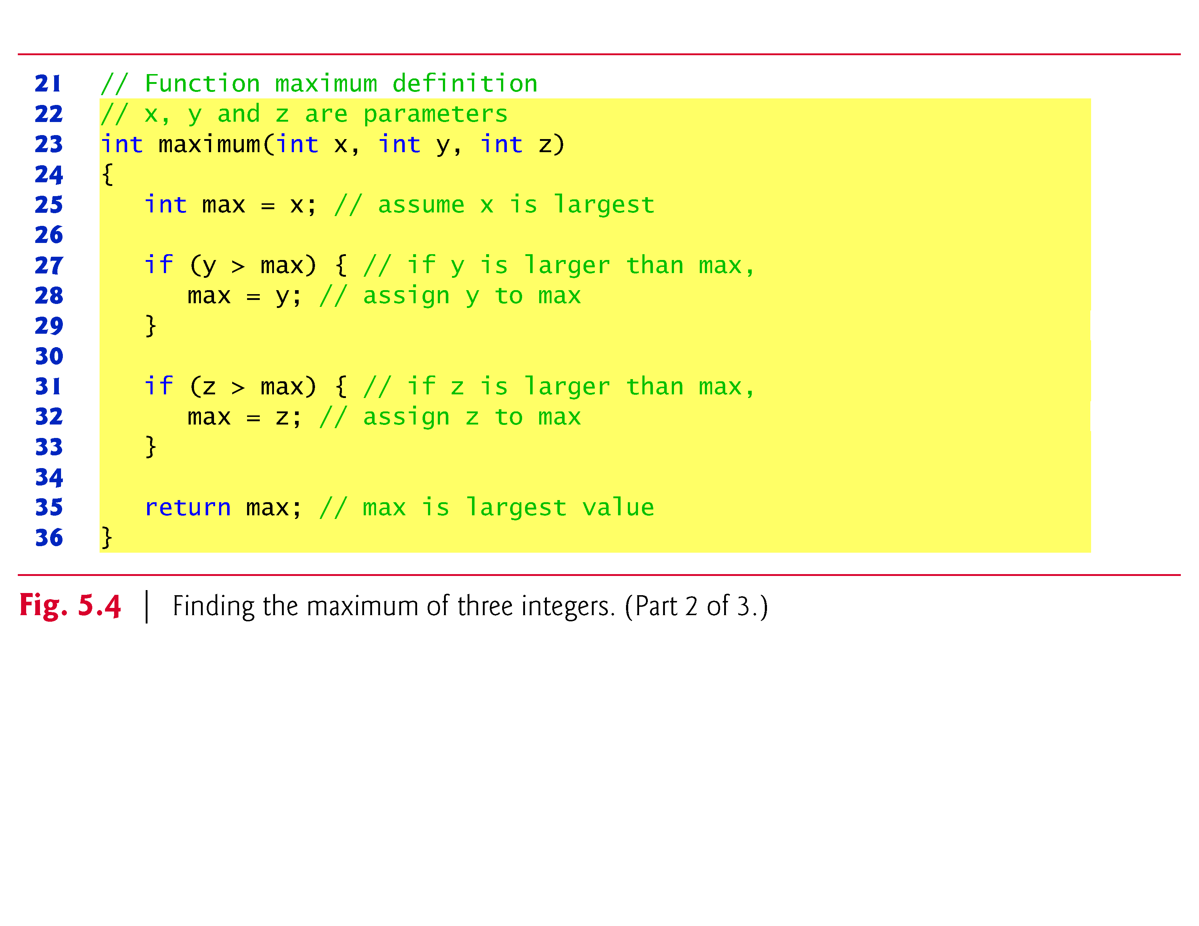

Slide 12
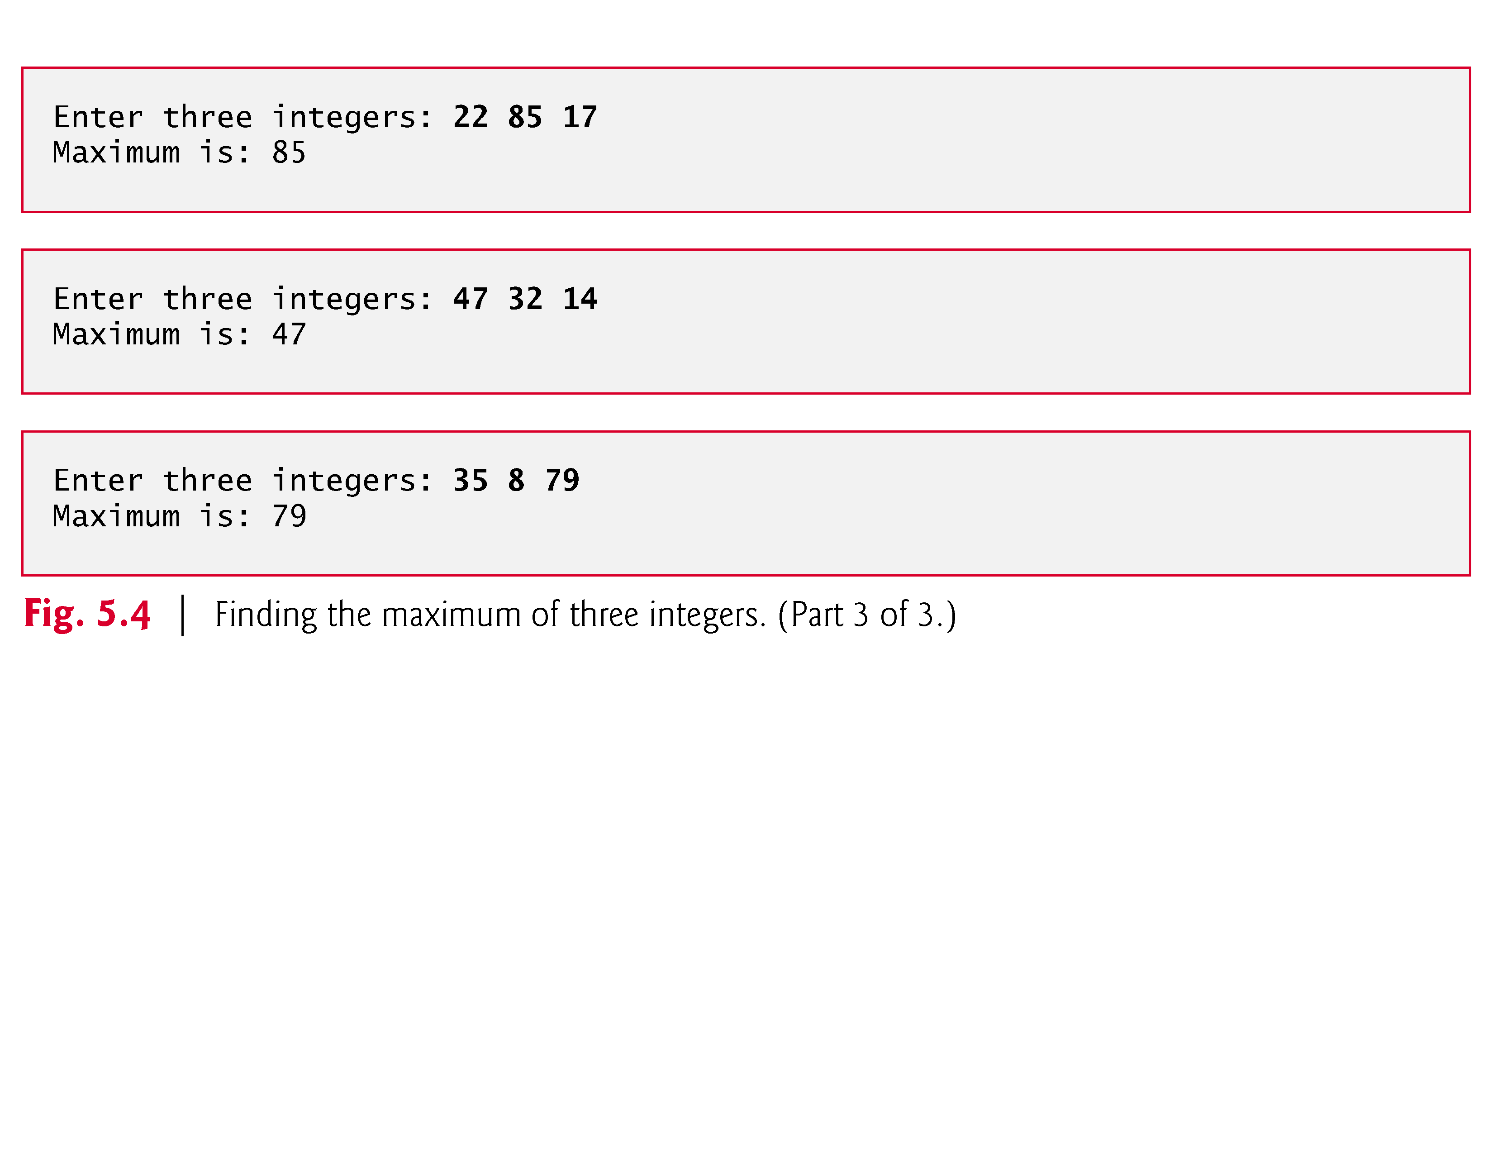

Slide 13
5.9 Passing Arguments By Value and By Reference. WE WILL COVER THIS TOPIC IN POINTERS
In many programming languages, there are two ways to pass arguments—pass-by-value and pass-by-reference.
When arguments are passed by value, a copy of the argument’s value is made and passed to the called function.
Changes to the copy do not affect an original variable’s value in the caller.
When an argument is passed by reference, the caller allows the called function to modify the original variable’s value.
Pass-by-value should be used whenever the called function does not need to modify the value of the caller’s original variable.

Slide 14
5.9 Passing Arguments By Value and By Reference (Cont.) WE WILL COVER THIS TOPIC IN POINTERS
This prevents the accidental side effects (variable modifications) that so greatly hinder the development of correct and reliable software systems.
Pass-by-reference should be used only with trusted called functions that need to modify the original variable.
In C, all arguments are passed by value.
In Chapter 6, we’ll see that array arguments are automatically passed by reference for performance reasons.

Slide 15
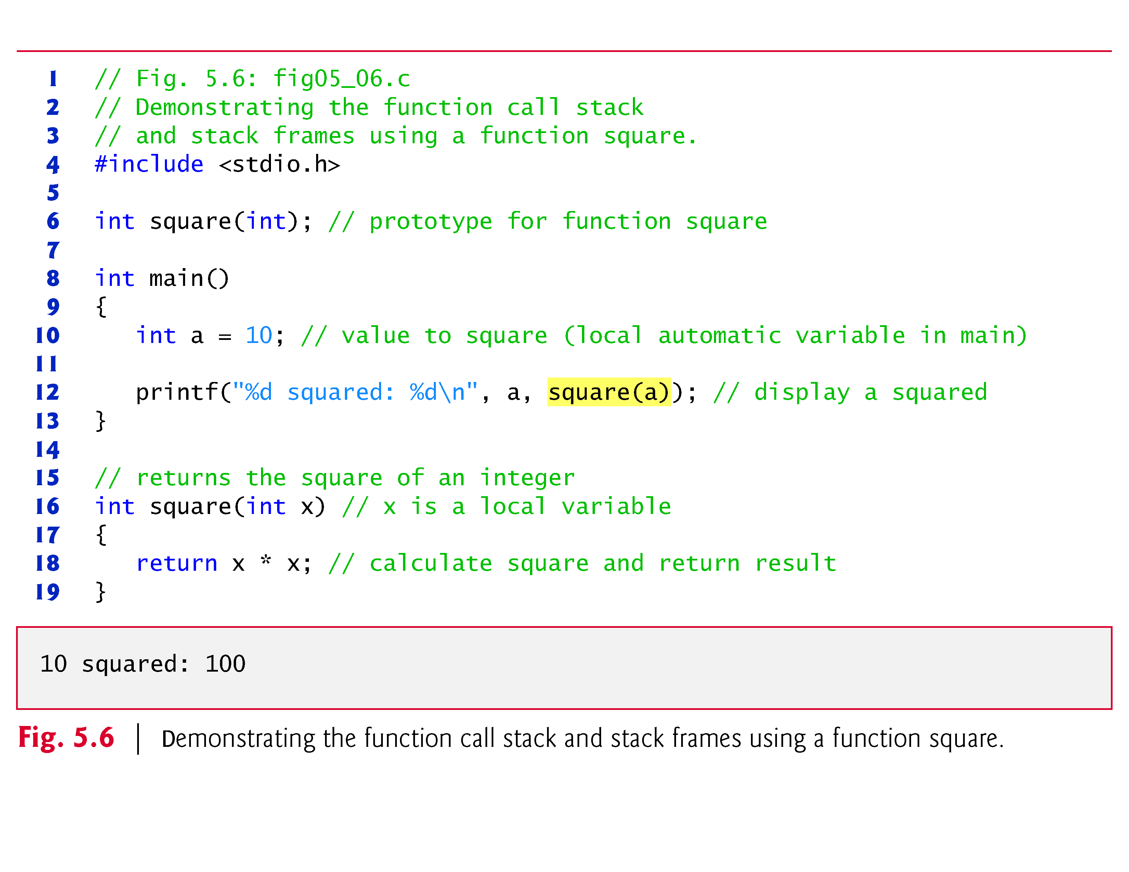

Slide 16
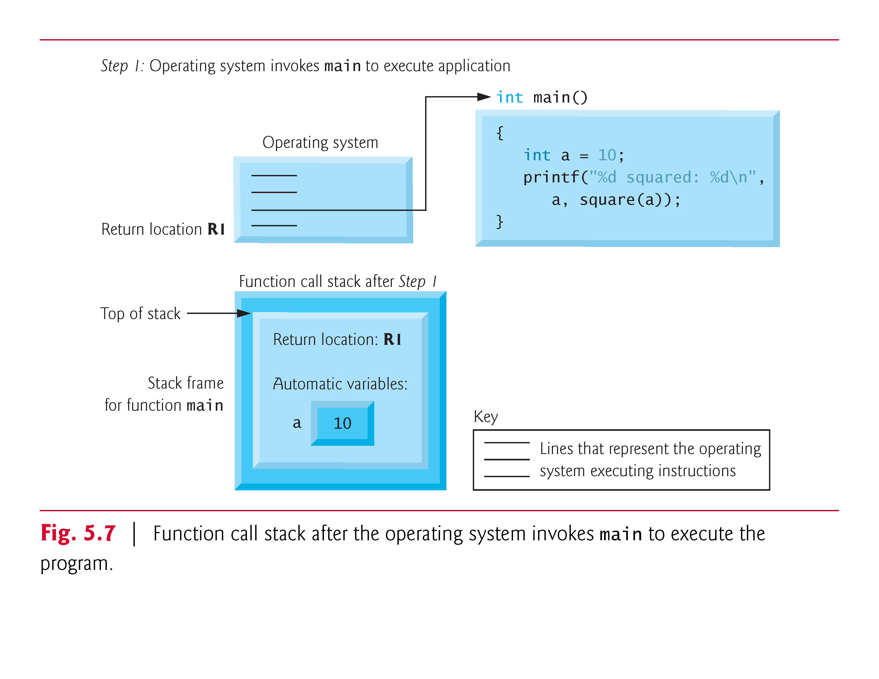

Slide 17
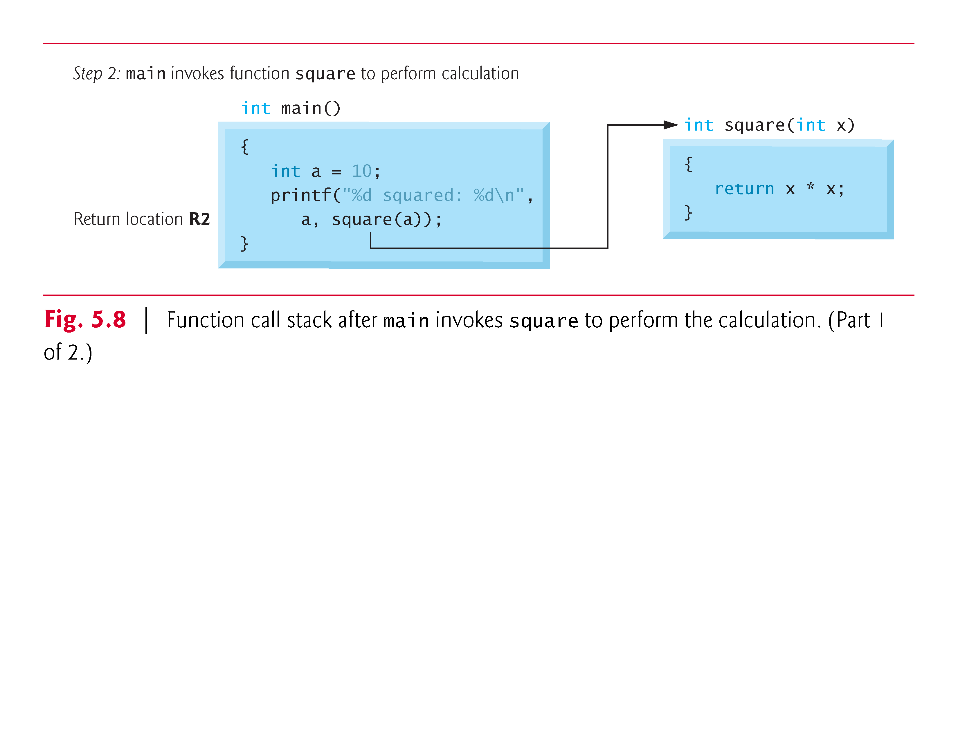

Slide 18
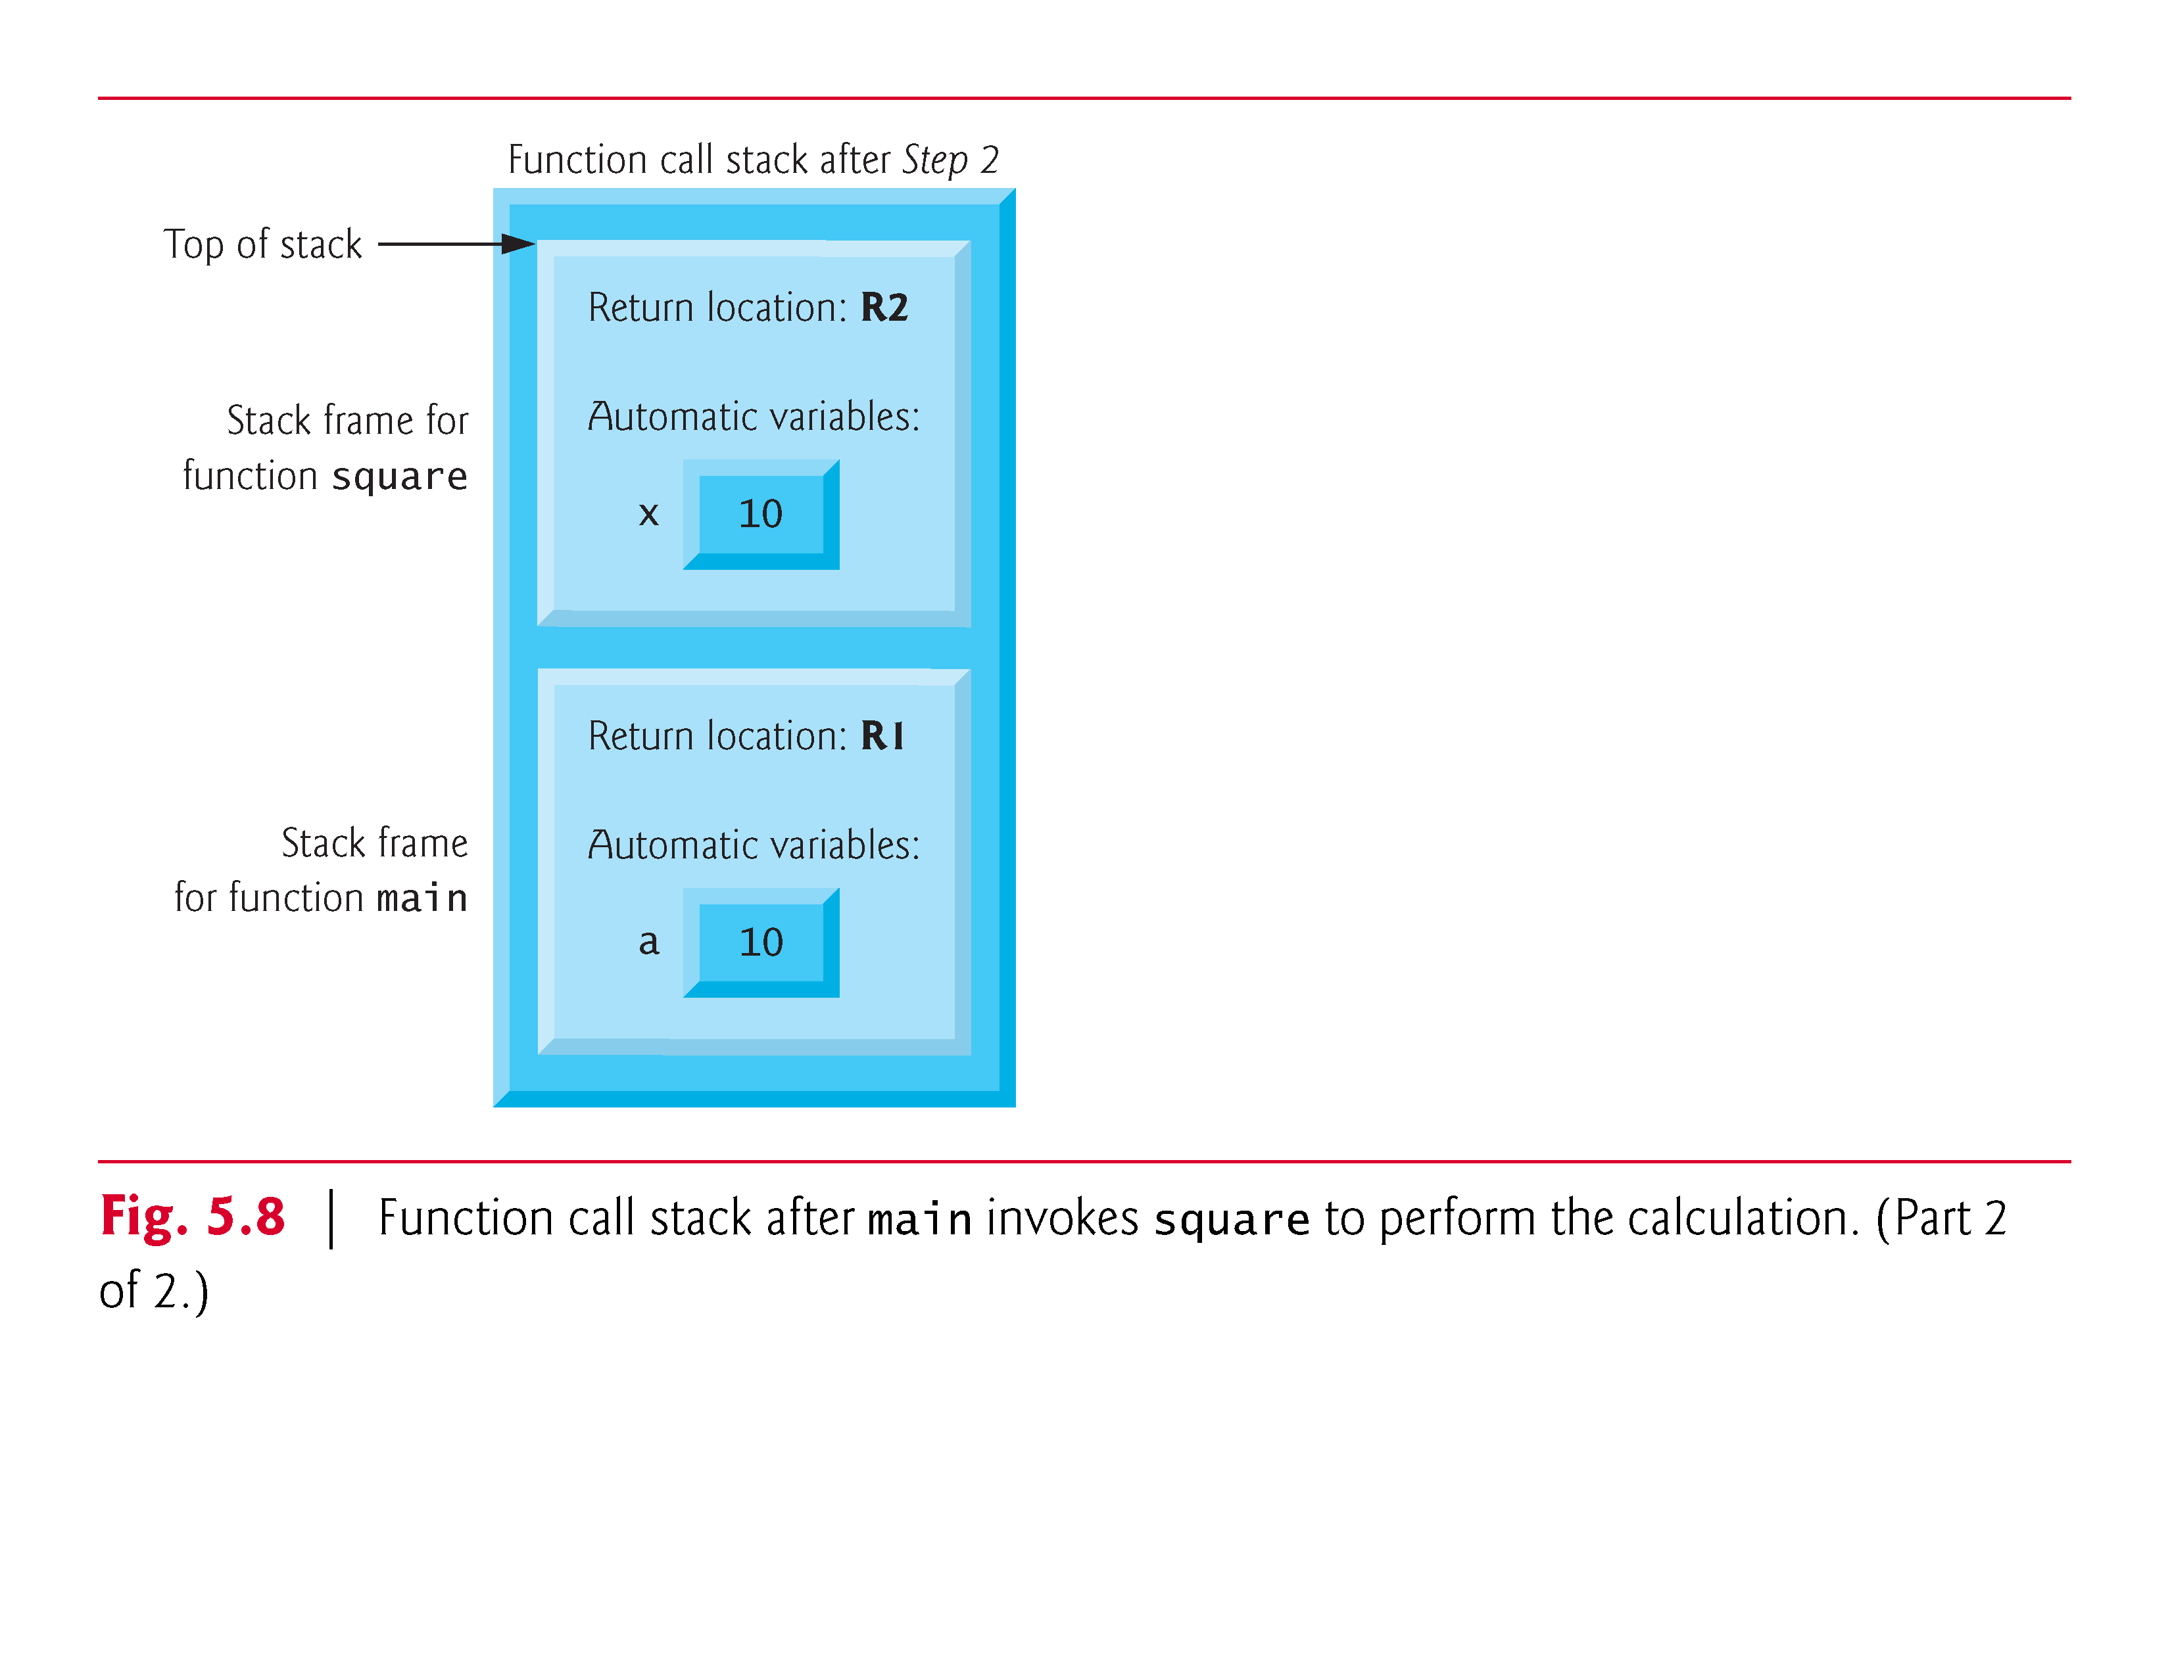

Slide 19
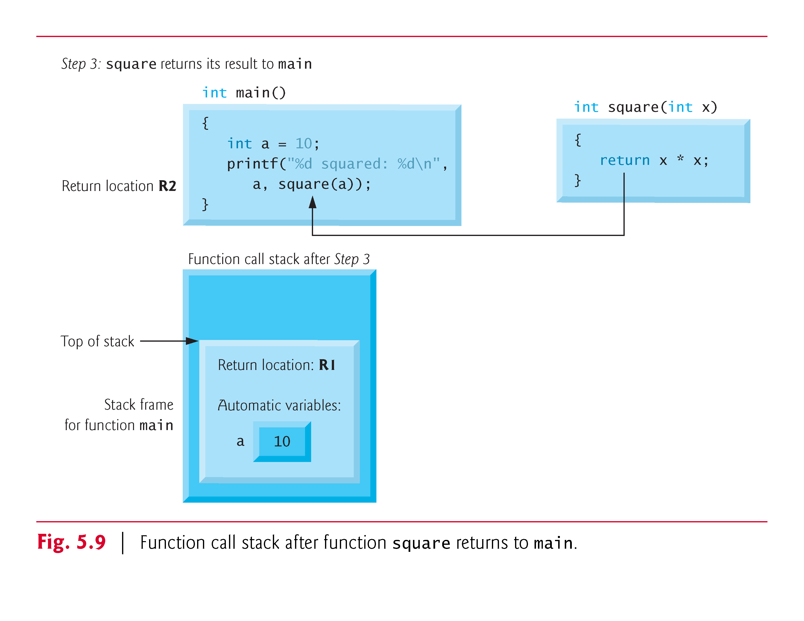

Slide 20
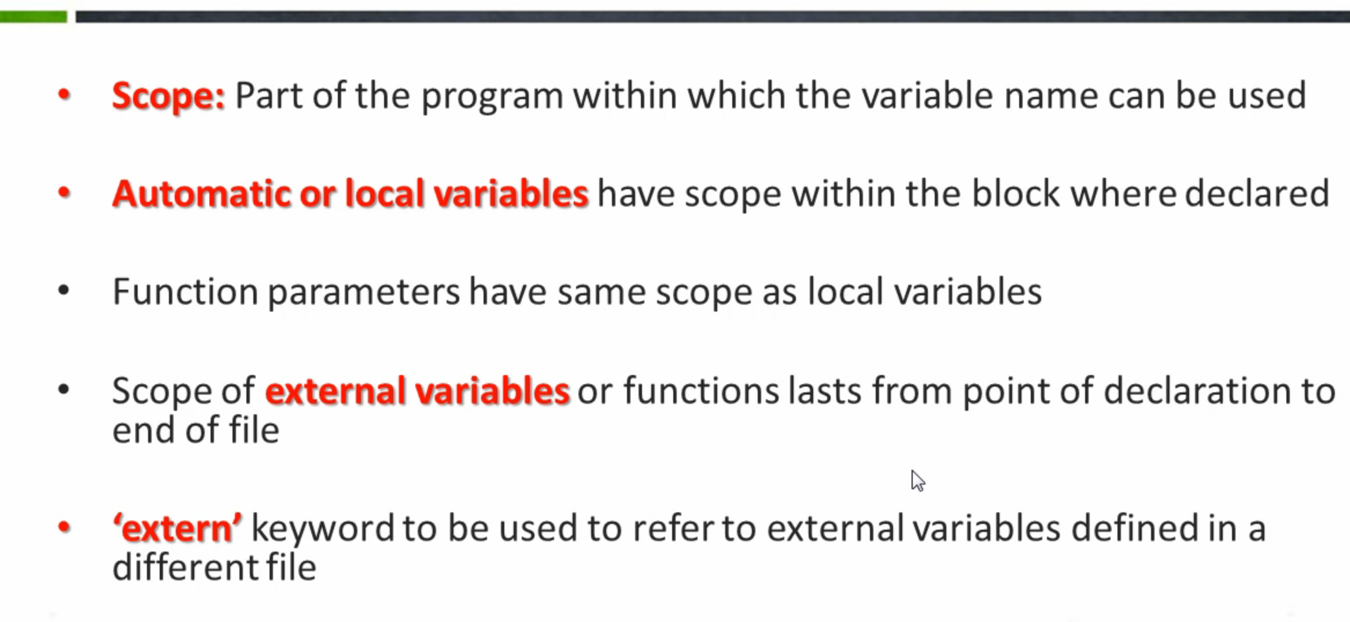
Scope Rules

Slide 21
Scope Rules (Cont.)
static still have block scope, even though they exist from before program startup.

Slide 22
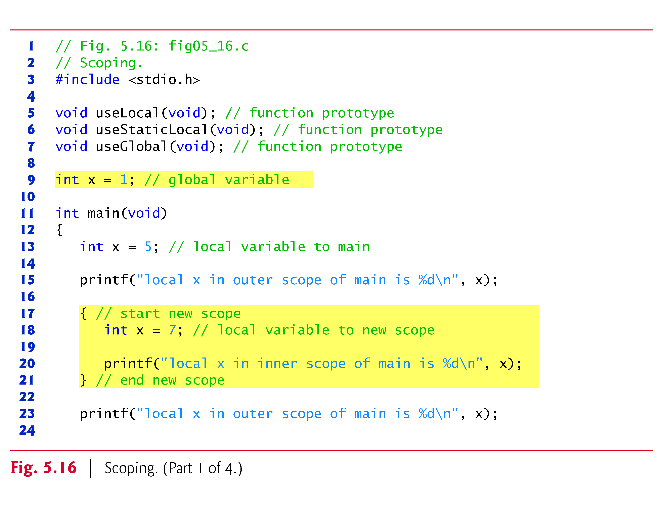

Slide 23
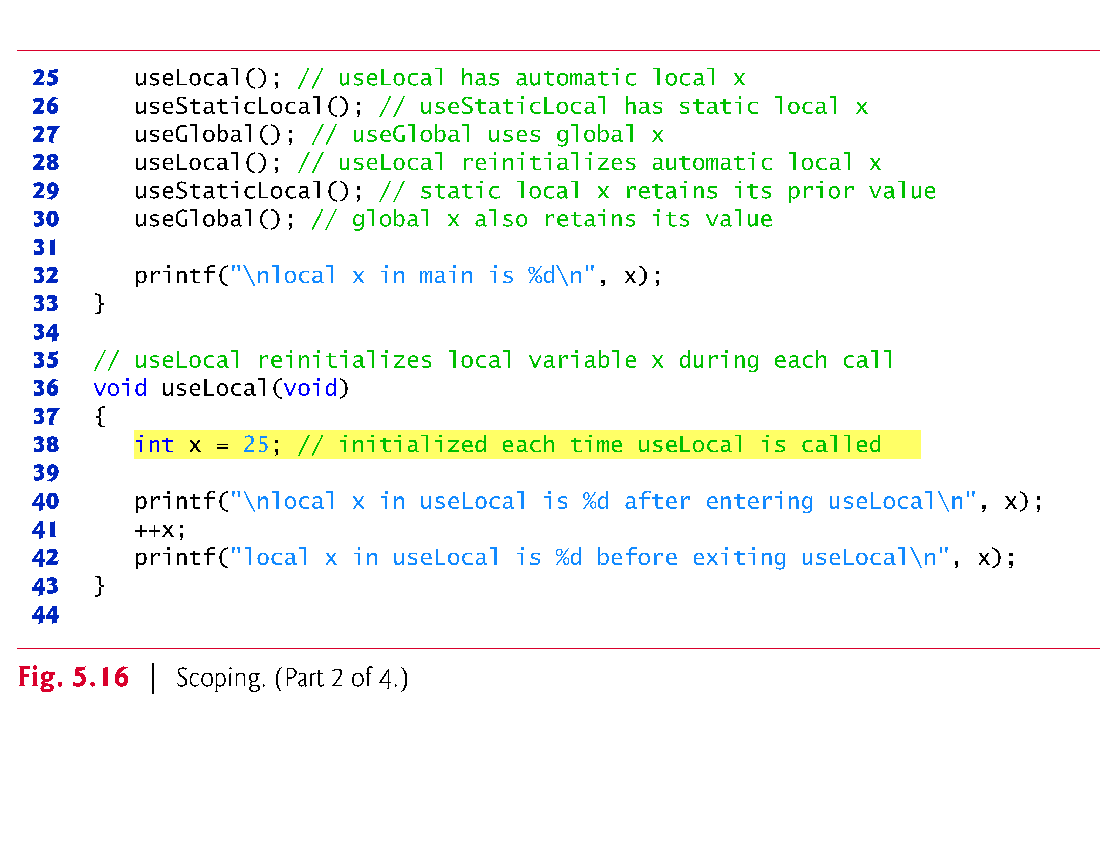

Slide 24
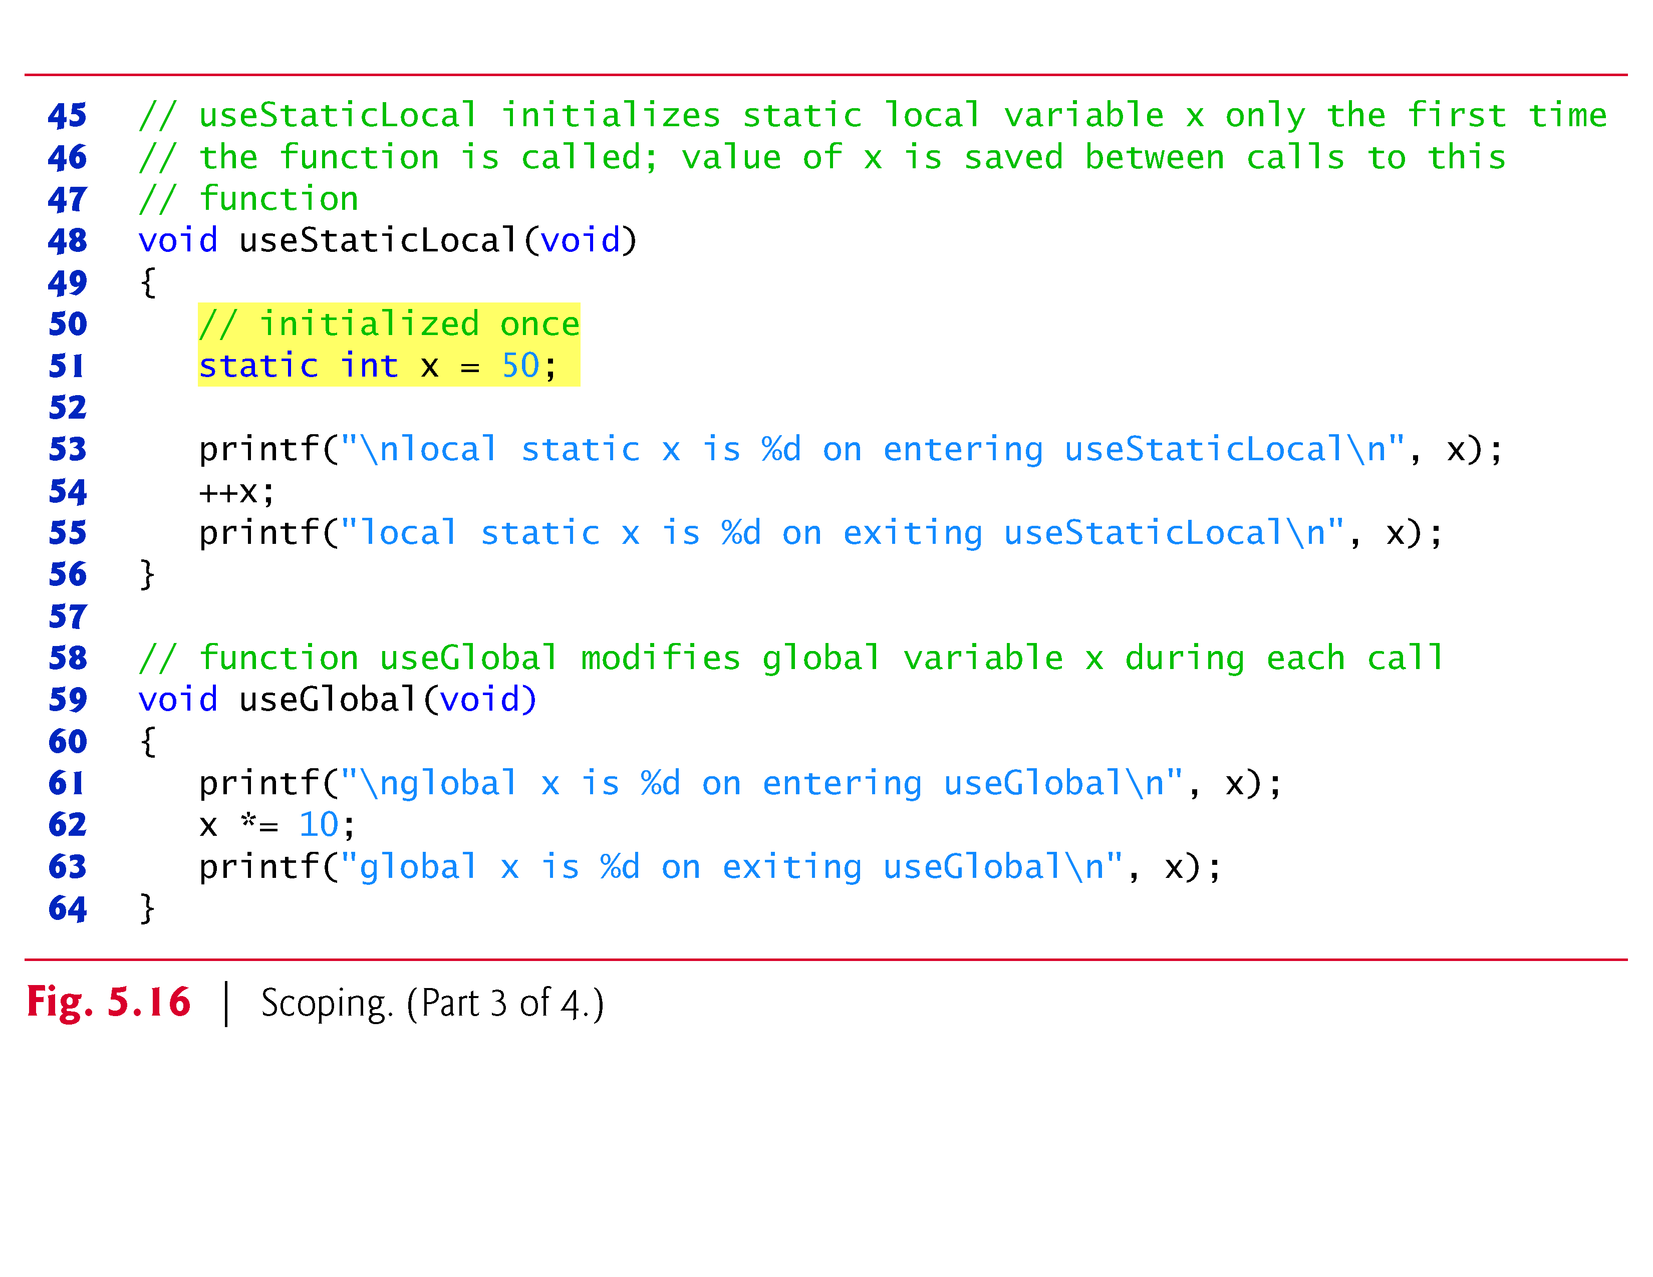

Slide 25
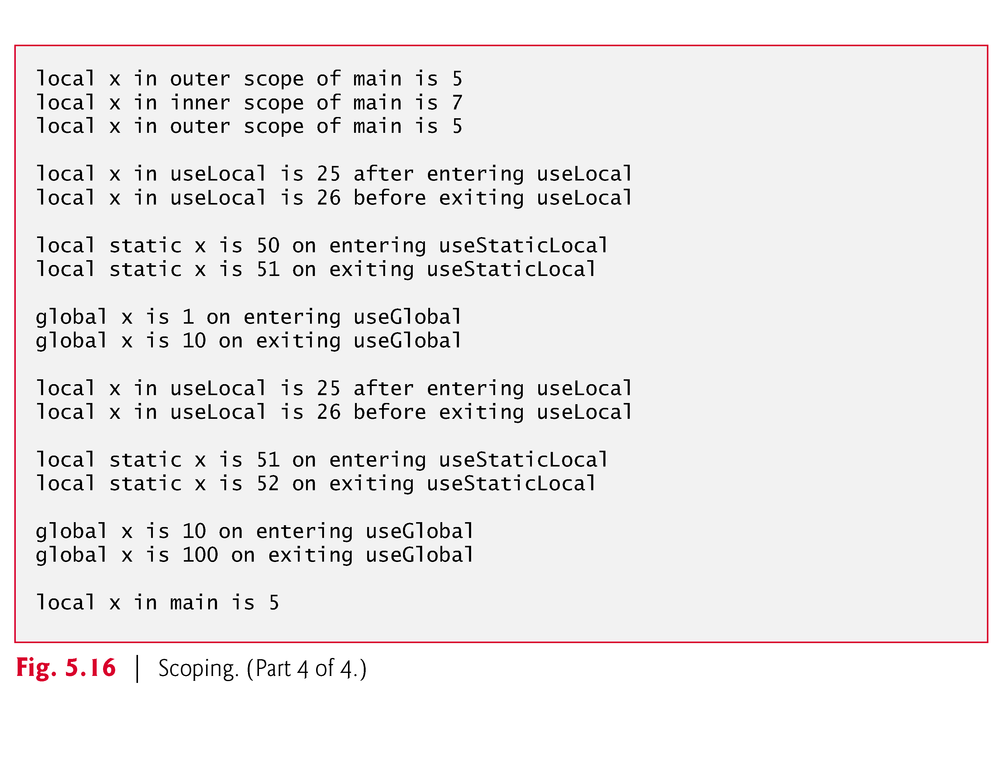

Slide 26
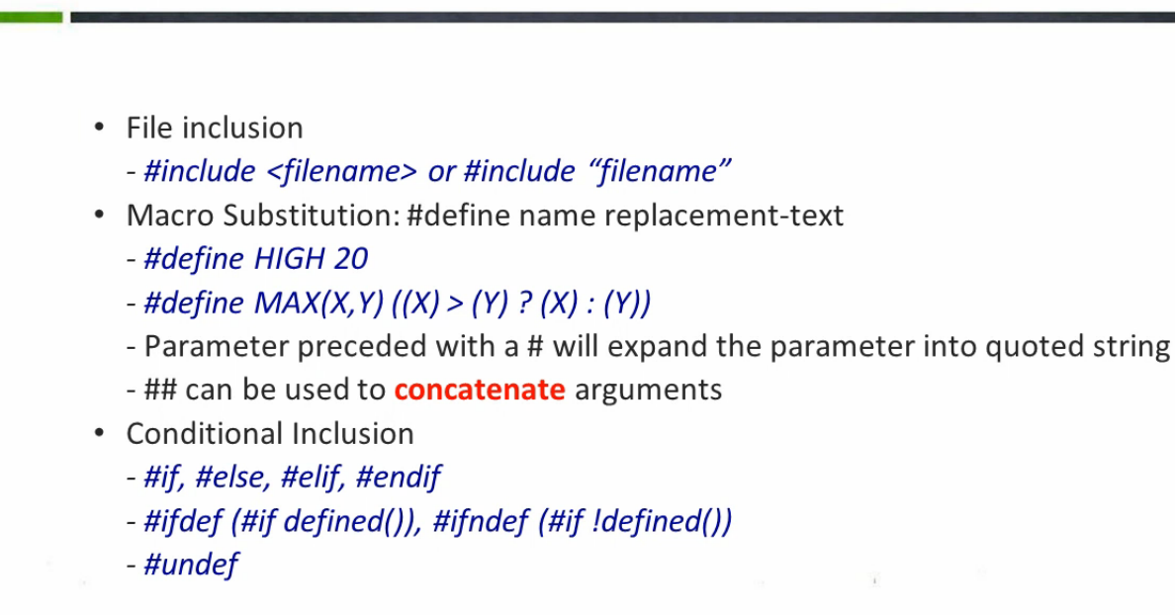
Preprocessor

Slide 27
#include <stdio.h>
#if 0
#define DUMMY 20
#else
#define DUMMY 10
#endif
int main(){
printf("%d\n",DUMMY);
return 0;
}
#include <stdio.h>
#define TEMP 10
#if defined(TEMP)
#define DUMMY 20
#else
#define DUMMY 10
#endif
int main(){
printf("%d\n",DUMMY);
return 0;
}

Slide 28
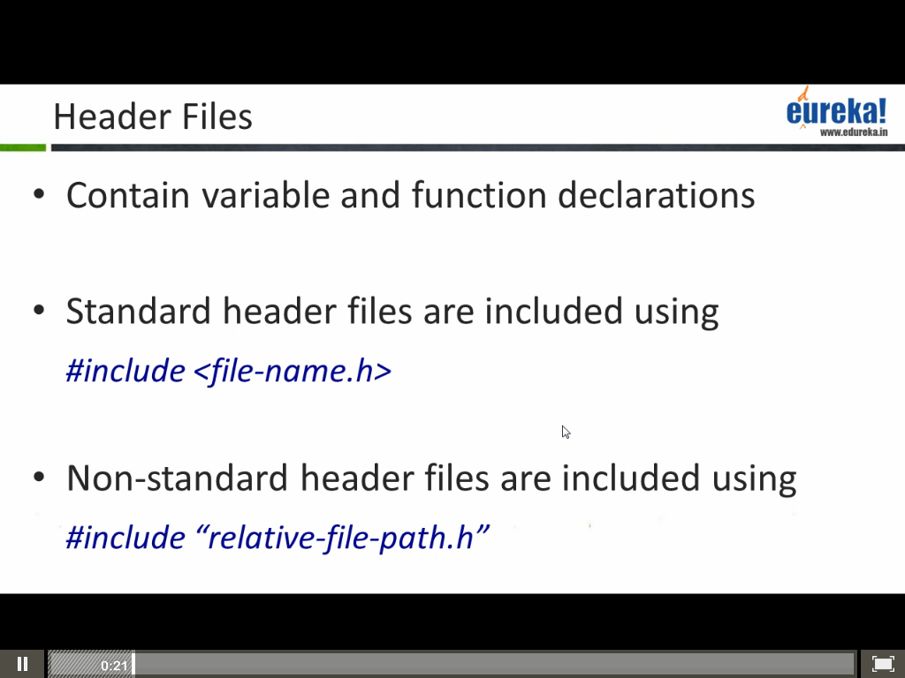
Header Files

Slide 29
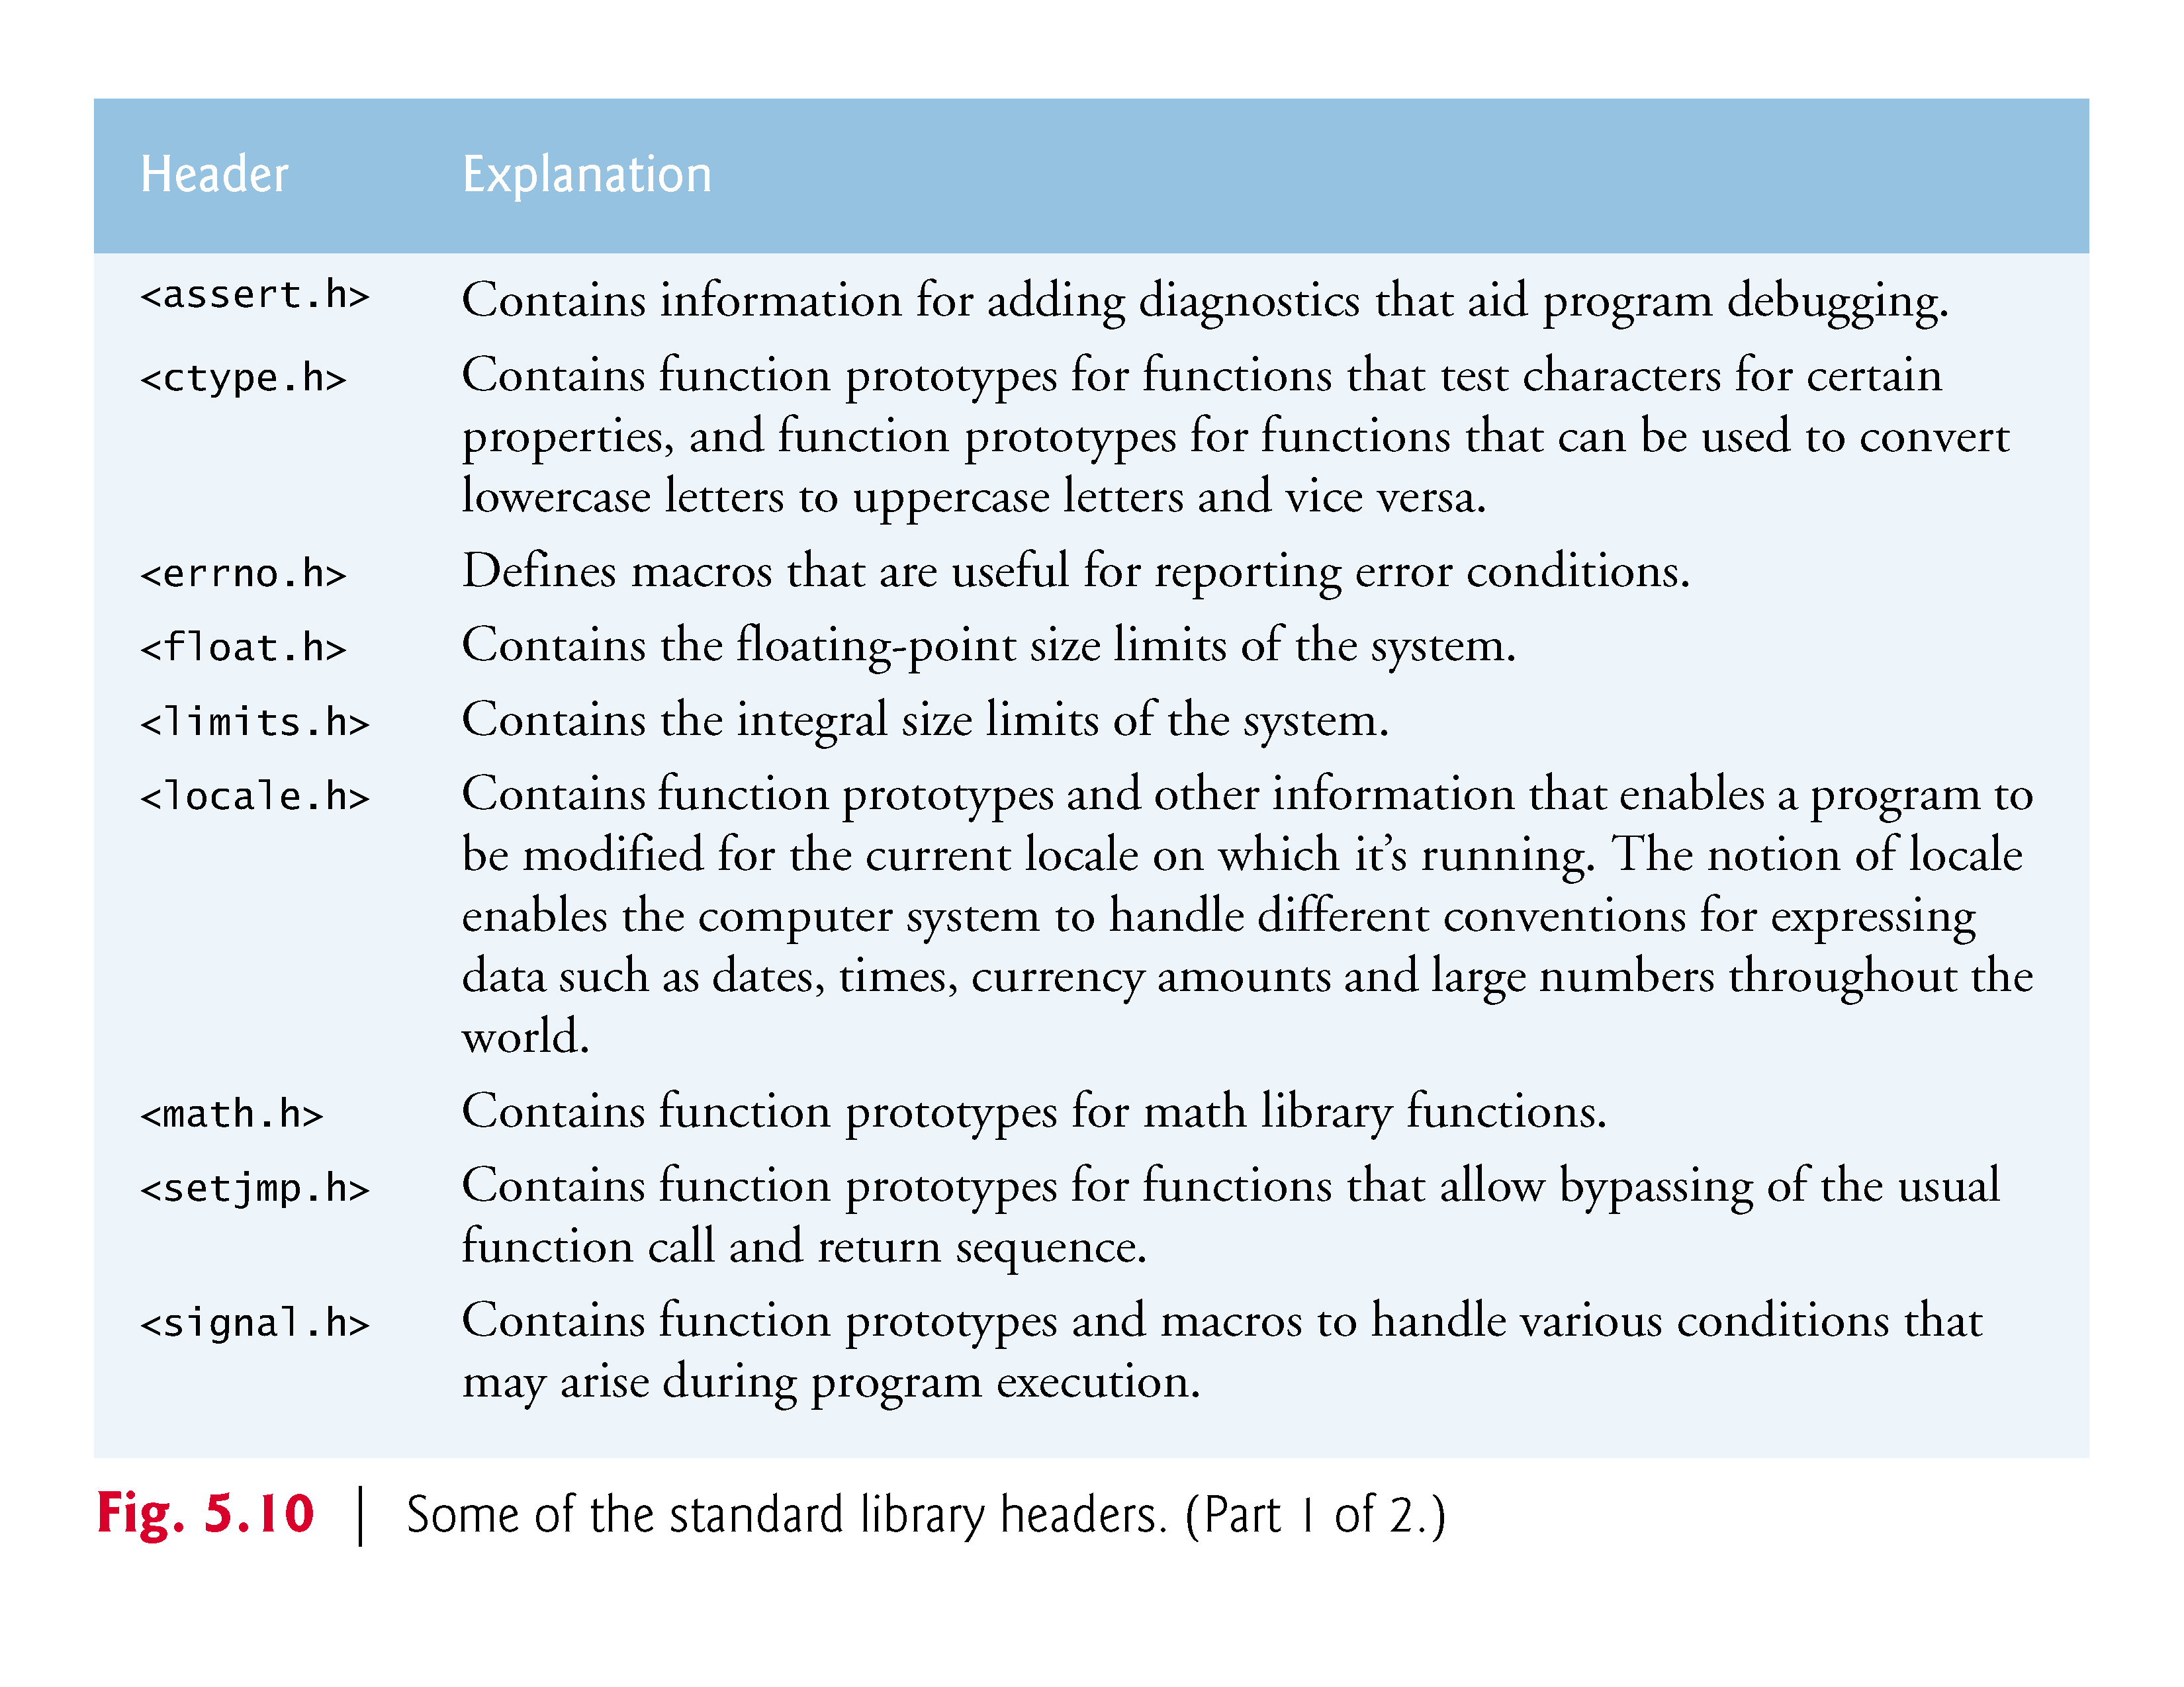

Slide 30
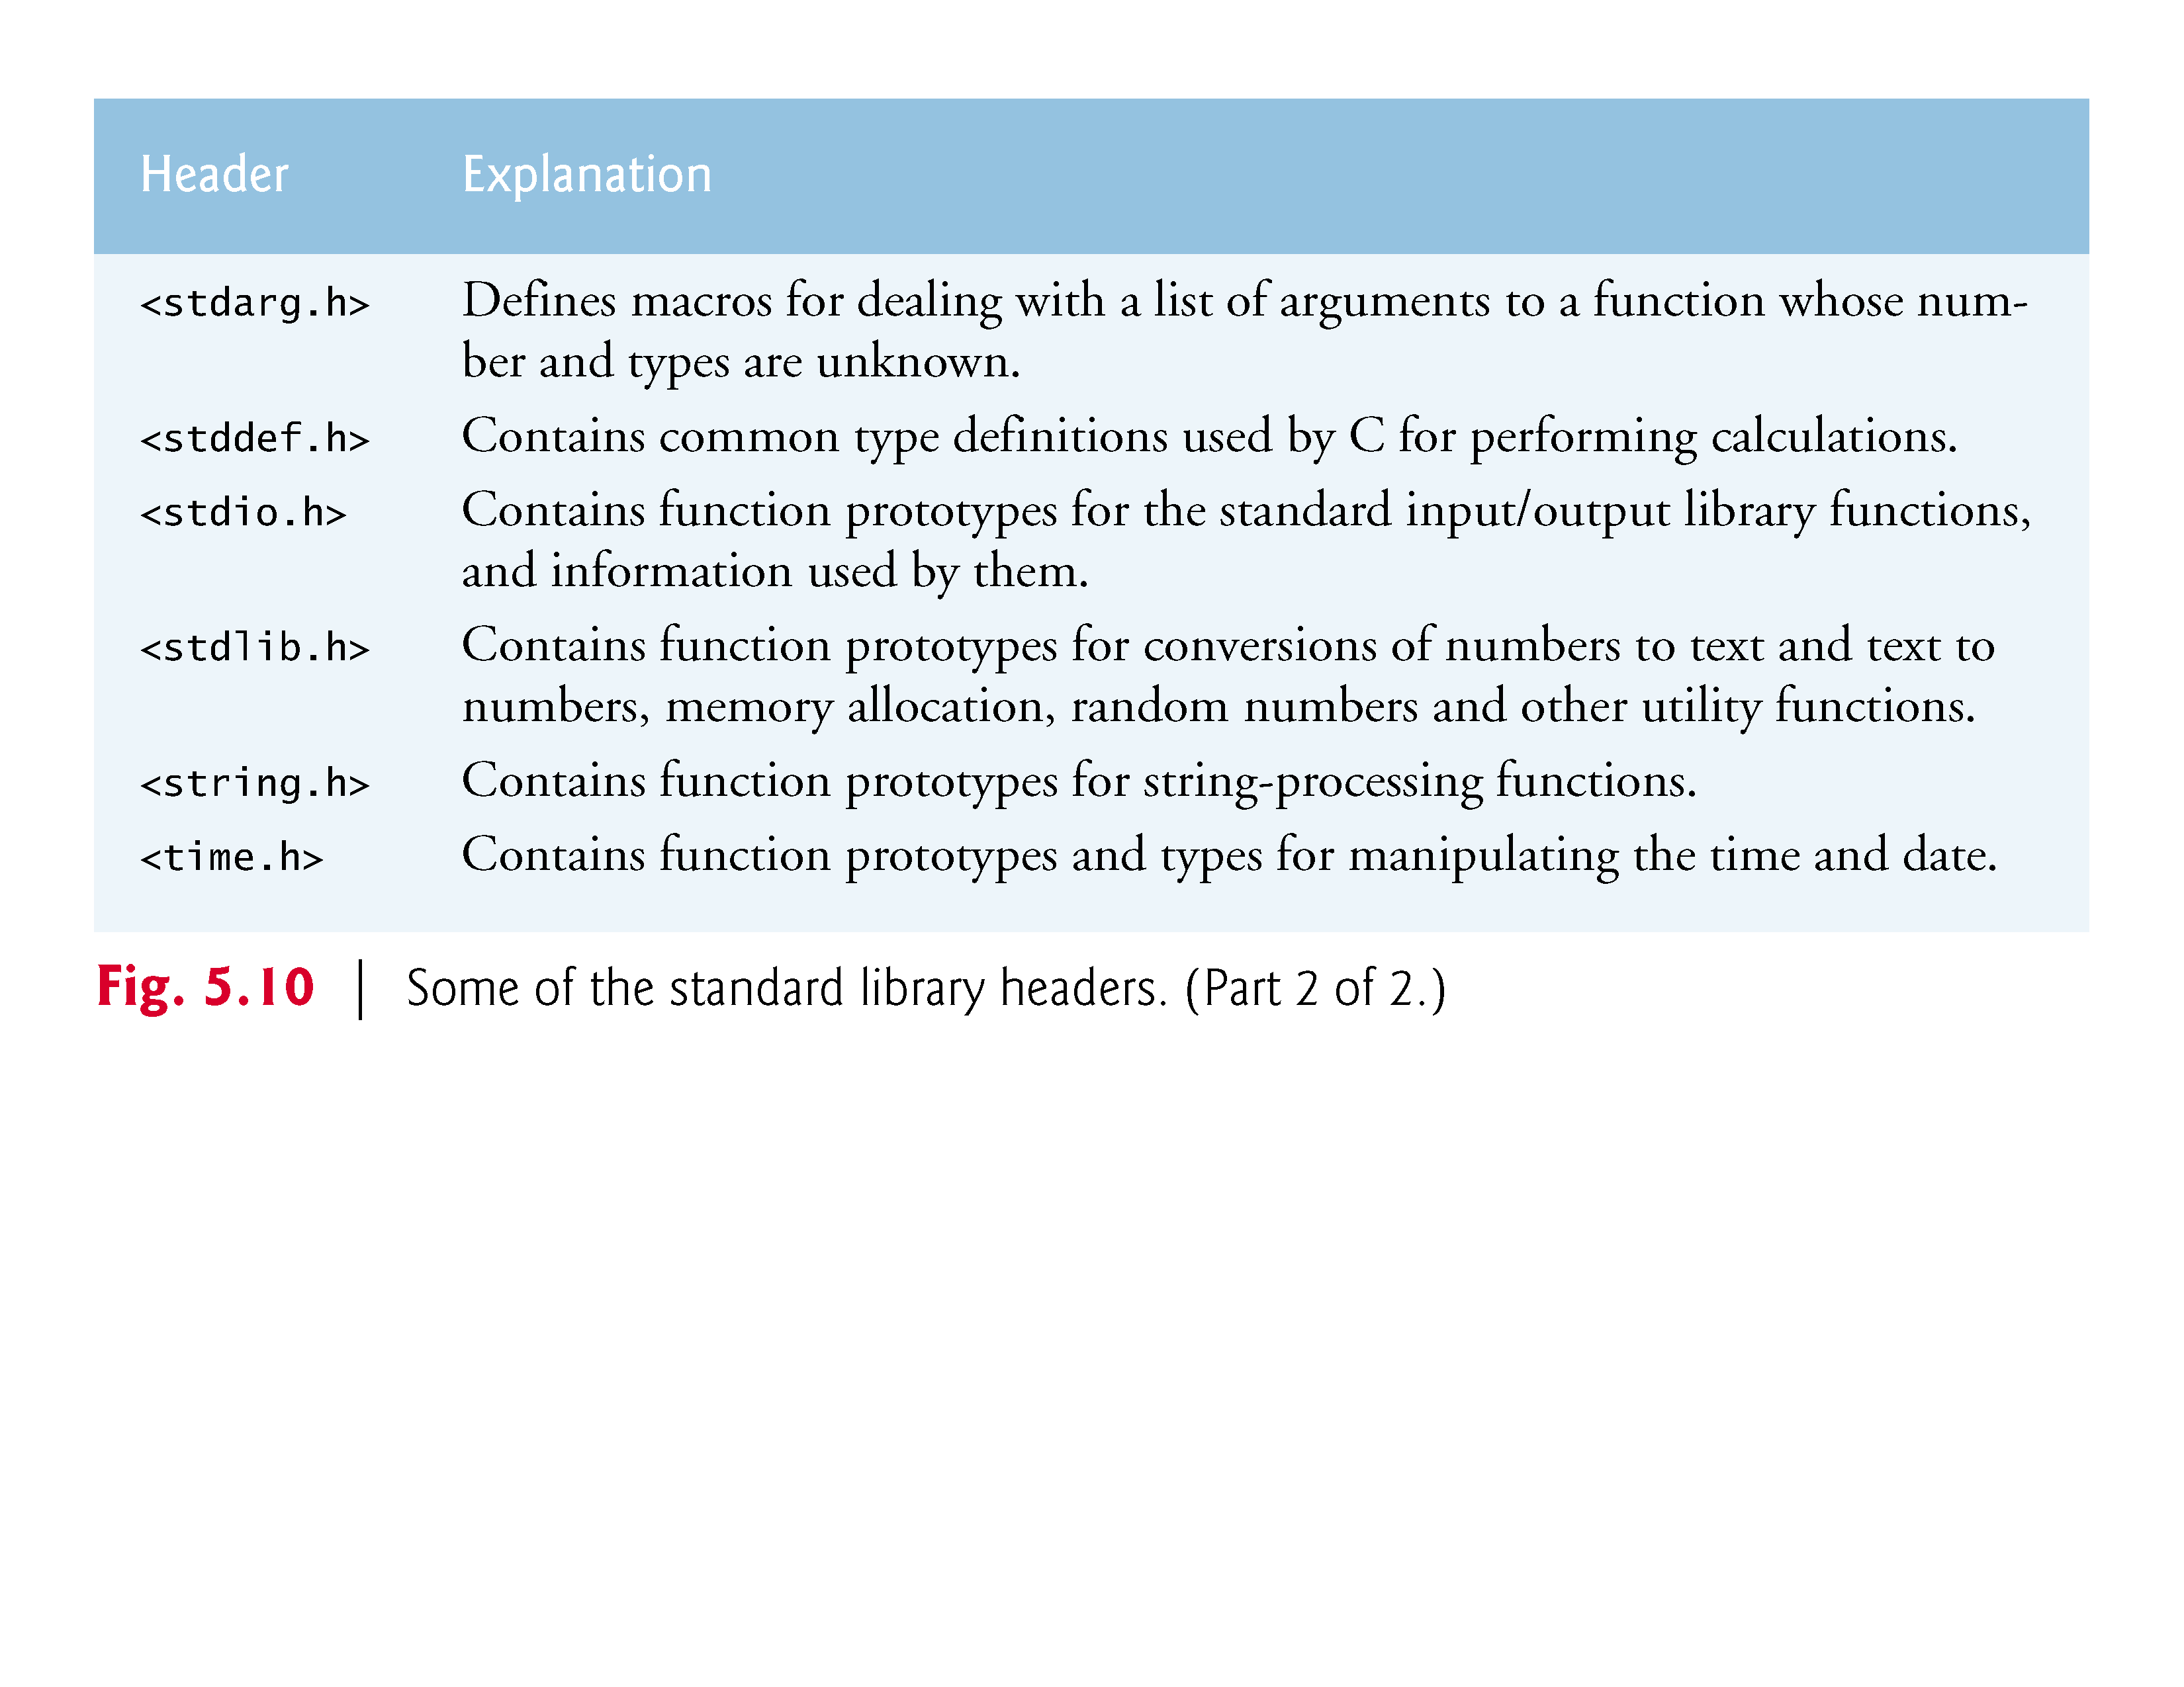

Slide 31
So far
Putting all what we learnt together in the next lab and on the last lecture of this week (Thursday).

Slide 32
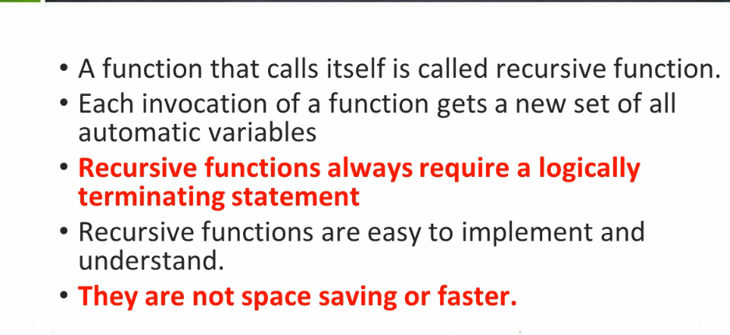
Recursion

Slide 33
Simple Recursion example
#include <stdio.h>
void rec(int n);
int main()
{
int n =6;
rec(n);
return 0;
}
void rec(int n)
{ printf("%d ",n);
if (n==0)
return;
else
return(rec(n-1));
}

